Slide 1
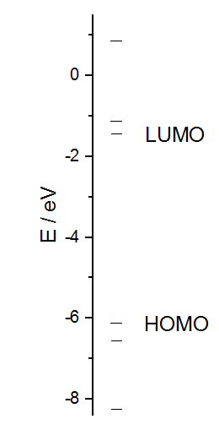
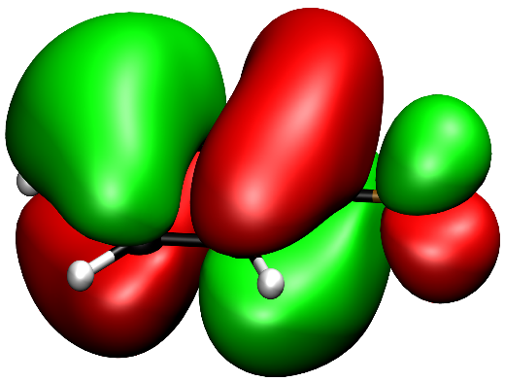
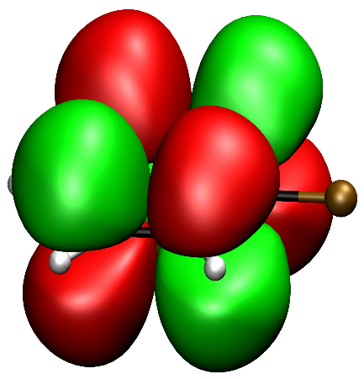
Calculation of molecular properties
Kevin Reiter, Mathias Lang 14.09.2017
HOMO
LUMO

Slide 2
Outline
Introduction
Quantum mechanics, Schrödinger equation
Approximations
Hartree-Fock, LCAO
Electronic correlation
Calculation of molecular properties
First derivatives
e.g. molecular gradients, electric dipole moment, magnetic dipole moment, …
Higher derivatives and mixed derivatives
e.g. harmonic vibrational frequencies, IR intensities, NMR shieldings, …
Illustrative examples
Summary

Slide 3
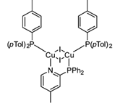
Introduction
What do we need for the calculation of molecular properties?
→ Solving the Schrödinger equation
: Hamilton operator (→ energy operator)
→
Impossible to solve!
N nuclei n electrons
Coordinates: R₁,…,R_{N} r₁,…,r_{n}
Charges: Z₁,…,Z_{N} q₁,…,q_{n}=-1
→ E, Ψ

Slide 4
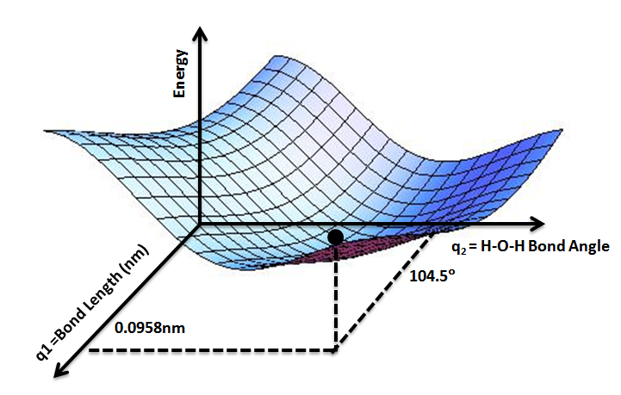
Introduction
Born Oppenheimer Approximation
m_{nucleus} >> m_{electron} → electrons move a lot faster → „Freeze the nuclear motion“
→ Coordinates of the nuclei are parameters (not variables anymore!)
Solve the electronic Schrödinger equation for different positions of the nuclei
→ E=E(R₁,…,R_{N})=E{R}: Potential energy surface

Slide 5
Introduction
Next approximation: Slater Determinant
Wave function as a product of single particle wave functions:
With Pauli Principle:
Using the variation principle :
→ Finding the best Slater determinant (→ yielding the lowest energy)
Hartree-Fock theory

Slide 6
Hartree-Fock procedure
With electron electron interaction: HF mean-field
Example: Coulomb energy:
To determine Ψ we need J, but J is a function of Ψ (→ J = J(Ψ))
„Ψ is needed to determine Ψ“ iterative process
Coulomb energy E_{J}
exchange energy E_{K}
Coulomb-Operator J(1)

Slide 7
Hartree-Fock procedure
To solve this:
„Guess“ Ψ^{SD}
→ Works, but not very efficient!
set up Fock operator
F[Ψ] = T[Ψ]+ V_{ne}[Ψ] + J[Ψ] + K[Ψ]
Solve F Ψ =E Ψ
→ new Ψ, E

Slide 8
Hartree-Fock procedure
Transforming HF equations into matrix eigenvalue problems → higher computer efficiency → more cost effective
→ MO´s written as linear combination of atom orbitals → HF-LCAO
„guess“ atomic coordinates, basis functions χ_{ν}, coefficients c_{iν}
Set up F in AO basis: F_{μν}; Transform to MO basis F_{ij}=c_{iν}F_{μν}c_{νj}
Diagonalize F_{ij} → eigenvalues ε_{i} and new coefficients c_{iν}
→ Output after convergence: orbital energies ε_{i}, LCAO-coefficients c_{νj} → ϕ_{i} → Ψ → E

Slide 9
Electron correlation
1 Problem left!
With HF mean-field → electrons only „feel“ average electron density of other electrons → In reality electrons avoid each other when to close
→ Energy gain (in reality, but not with HF mean-field)
→ E_{cor} = E_{exact} – E_{HF}
For HF → corrections like MP2, CCSD(T) (but time consuming)
DFT !
Also iterative process („guess electron density, iterate until convergence“)
Nowadays the standard tool for quantum chemistry

Slide 10
Calculation of molecular properties
First derivatives
Molecular (nuclear) gradient:
Electric dipole moment:
Magnetic dipole moment:
Hyperfine coupling constant:

Slide 11
Molecular gradient: Structure optimization
As we can calculate E, Ψ → Calculation of molecular properties
Example: Structure optimization: lowest energy for nuclear positions R
Analytically:
„Guess“ nuclear positions {R}
Use HF/DFT for {R} → E, Ψ, etc. Calculate
relax structure → new {R}
Upon Convergence: → Optimized structure parameters, total energy, orbitals!
Numerically: → needs 3N energy calculations → expensive

Slide 12
Molecular gradient: Structure optimization
: change of the Hamiltonian when moving nuclei: well feasible when LCAO is used
: change of the wave function when moving nuclei: generally hard: requires to solve so called Coupled Perturbed HF (CPHF) equations for first derivatives at HF or DFT level this can be avoided
OVERALL: If E and Ψ are calculated, gradients of E are cheap at HF or DFT level

Slide 13

Molecular gradient: Structure optimization
Computational Example: Structure optimization of C₆H₅F
1 a.u. = 2625 kJ/mol
0,20
0,15
$$\left|∂E/∂R\right|$$
0,10
DFT-functional: BP86
AO basis set: SV(P)
(„BP86/SV(P)“)
CPU time: 1 minute
(TURBOMOLE)
0,05
0,00
E / a.u.
0
2
4
6
8
10
12
14
16
cycle
cycle

Slide 14
Electronic dipole moment
Further properties via external perturbations, e.g. electric field F
μ: total dipole moment, μ₀: permanent dipole moment, α: polarizability
On the other hand (Taylor series):
coefficients from HF/DFT
e.g.: μ(C₆H₅F): 1.23 Debye (CPU<1second)

Slide 15
Magnetic dipole moment
Magnetic field B similar to electric field F, but: B interacts with particles by their movement (Lorentz force) → momentum: p_{kin}+A = π, B=rot(A)
A is not uniquely defined, convenient choice: → results become dependent on the choice of R Can/has to be corrected by using so-called „London atomic orbitals“
Then one can calculate e.g.: magnetic moment:

Slide 16
Hyperfine coupling constant
Further properties via internal perturbations: magnetic moments Nuclear moments I₁, I₂,…
Nuclear-electron
hyperfine coupling constant
NMR
coupling constant

Slide 17
Calculation of molecular properties
Higher derivatives and mixed derivatives
Harmonic vibrational frequencies:
IR-spectrum intensities:
Raman-spectrum intensities:
NMR shielding:

Slide 18
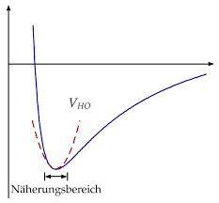


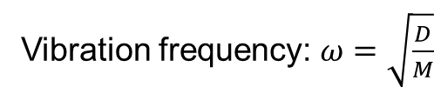
Harmonic vibrational frequencies
Harmonic approximation (valid only where $\frac{∂E}{∂R}=0)$:
E(R)
R
M₁
M₂
E_{HO}
R
$$\frac{1}{M}=\frac{1}{M_{1}}+\frac{1}{M_{2}}$$
Vibration frequency: $ω=\sqrt{\frac{D}{M}}$

Slide 19
Harmonic vibrational frequencies
unproblematic, can be eliminated, but is required CPHF equations have to be solved:
cheaper than numerically but still much more expensive than gradients
: numerically from gradients:
3N energy calculations
required
analytically:

Slide 20
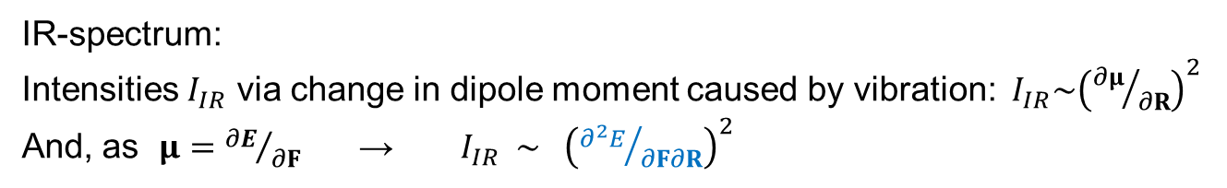
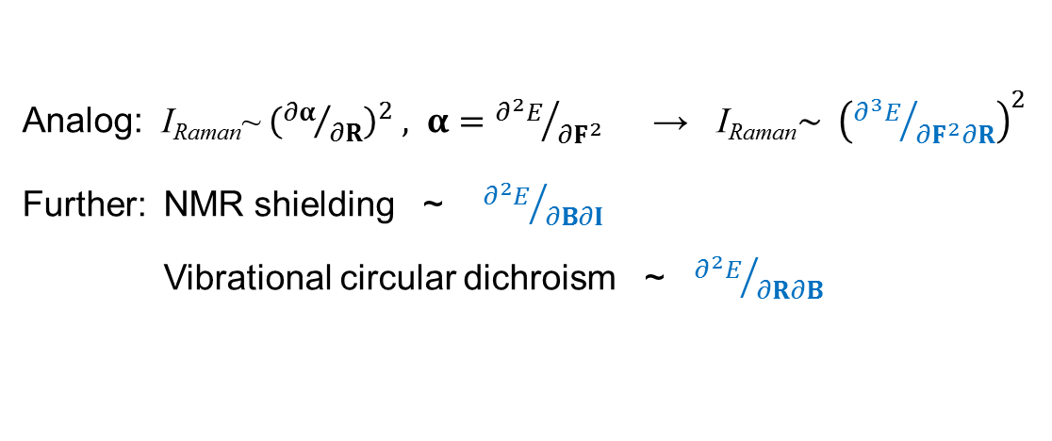
Further properties: mixed derivatives
So far only first and higher derivatives with respect to one parameter (R, F, B, I)
IR-spectrum: Intensities $I_{IR}$ via change in dipole moment caused by vibration: $I_{IR}\sim {\left({∂μ}/{∂R}\right)}^{2}$
And, as $μ={∂E}/{∂F}$ → $I_{IR} \sim {\left({∂^{2}E}/{∂F∂R}\right)}^{2}$
Analog: I_{Raman}~ ${\left({∂α}/{∂R}\right)}^{2} , α={∂^{2}E}/{∂F^{2}}$ → I_{Raman}$\sim {\left({∂^{3}E}/{∂F^{2}∂R}\right)}^{2}$
Further: NMR shielding ~ ${∂^{2}E}/{∂B∂I}$ Vibrational circular dichroism ~ ${∂^{2}E}/{∂R∂B}$
In general: property ~

Slide 21
Further ground state properties and derivatives:
n_{R} | n_{F} | n_{B} | n_{I} | Property
0 | 0 | 0 | 0 | Energy
1 | 0 | 0 | 0 | Molecular (nuclear) gradient
0 | 1 | 0 | 0 | Electric dipole moment
0 | 0 | 1 | 0 | Magnetic dipole moment
0 | 0 | 0 | 1 | Hyperfine coupling constant
2 | 0 | 0 | 0 | Harmonic vibrational frequencies
0 | 2 | 0 | 0 | Electric polarizability
0 | 0 | 2 | 0 | Magnetizability
0 | 0 | 0 | 2 | Nuclear spin–spin coupling
1 | 1 | 0 | 0 | Infrared absorption intensities
0 | 1 | 1 | 0 | Optical rotation, circular dichroism
0 | 0 | 1 | 1 | Nuclear magnetic shielding
1 | 0 | 1 | 0 | Vibrational circular dichroism intensities
3 | 0 | 0 | 0 | Anharmonic corrections to vibrational frequencies
0 | 3 | 0 | 0 | Electric hyperpolarizability
0 | 0 | 3 | 0 | Hyper magnetizability
1 | 2 | 0 | 0 | Raman intensities

Slide 22
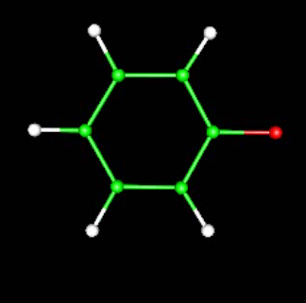
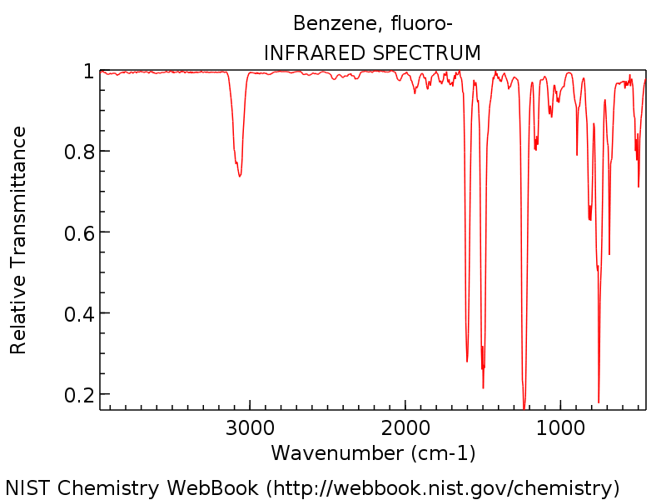
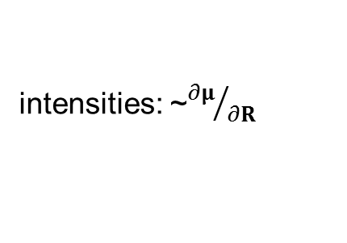

Illustrative example: IR spectrum of C₆H₅F
From QC only:
Which vibration causes
this peak?
80
Calculated
(BP86/SV(P)
0.8 minutes)
60
40
Intensity (from $∂μ/∂R)$
intensities: ~${∂μ}/{∂R}$
20
0
4000
3500
3000
2500
2000
1500
1000
500
0
wavenumber 1/cm
measured
(transmittance)

Slide 23
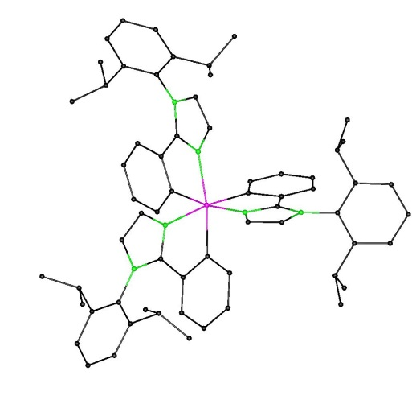
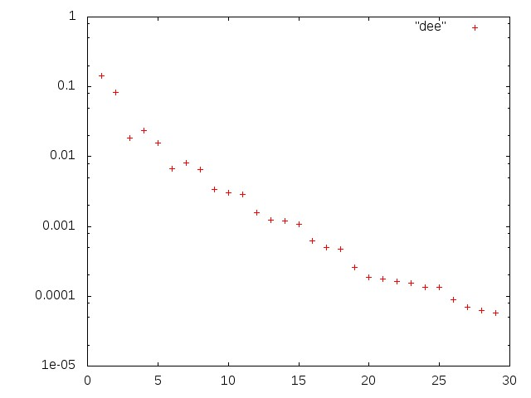
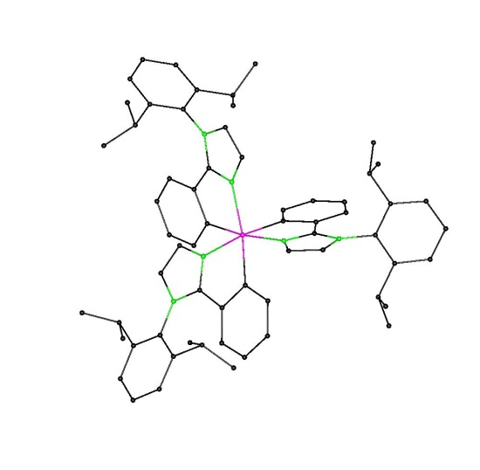
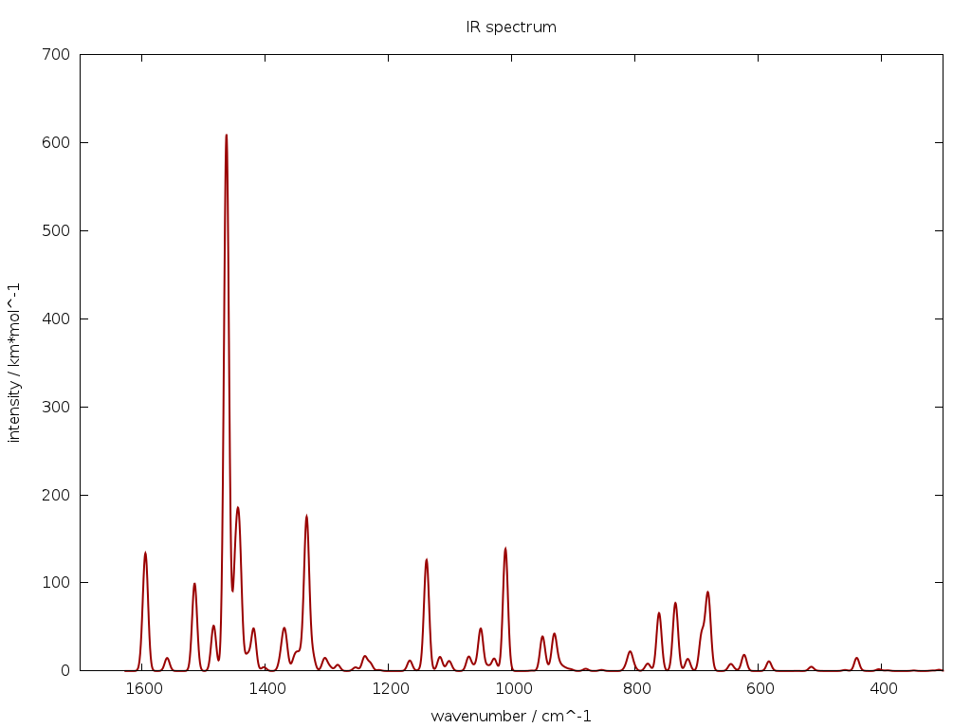
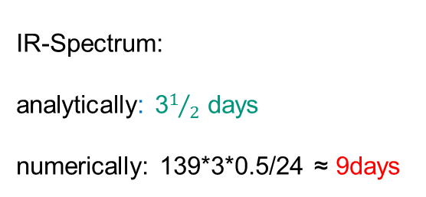
„Real“ Example: Optimization and IR spectrum of an OLED molecule
Energy (+Ψ): 0.4 h
Gradient: 0.1 h
Relaxation: 0.001h
25cycles → 1/2 day
139 atoms
IR-Spectrum:
analytically: 3$1/2$ days
numerically: 139*3*0.5/24 ≈ 9days
cycles
Parallel computing: quite efficient
8 CPUs → Wait for IR spectrum ½ day.

Slide 24
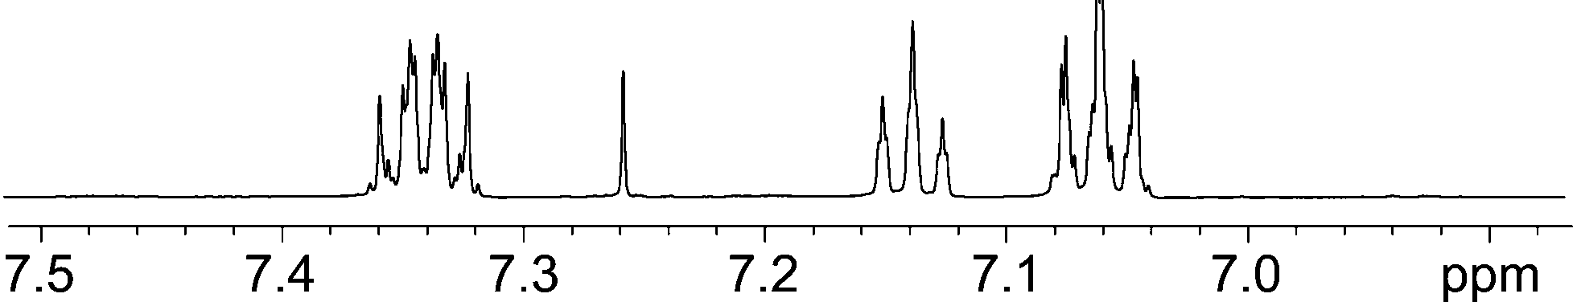
Illustrative example: NMR shieldings of C₆H₅F
Calculated (absolute) shieldings in ppm:
From QC: entire shilding tensors:
shielding tensor
24.04 -37.99 0
-29.53 -6.97 0
0 0 160.83
6.15
(p)
284.66
50.87
24.16
44.37
59.30
Measured ¹H shift:
(m)
(o)
m p o
23.92
24.27
→ compare relative numbers only, change sign
(depending on reference compound)
23.9 24.0 24.1 24.2 24.3
J. Aguilar, G. Morris, A. Kenwright, RSC Adv. 4, 8278 (2014).
CPU-time (B3LYP/TZVP): 1.6 minutes

Slide 25
Summary
Basics of cumputational quantum chemistry
In QC it is necessary to solve the Schrödinger equation for molecules → E, Ψ
Approximations needed for solving the Schrödinger equation e.g. Born-Oppenheimer
Basics of Hartree Fock theory → Product-Ansatz → Slaterdeterminant → Hartree-Fock equations → self consistent solution of a coupled matrix eigenvalue problem
Electron correlation can be included by so called post-Hartree-Fock methods like MP2 or Coupled Cluster
Density functional theory is a (nearly) universal tool for systems of up to 1000 atoms

Slide 26
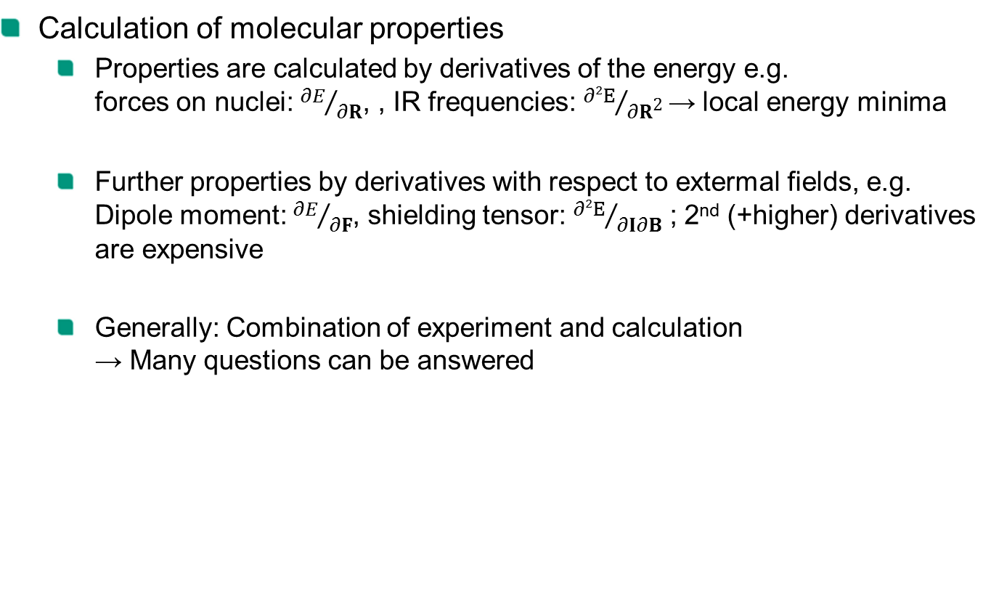
Summary
Calculation of molecular properties
Properties are calculated by derivatives of the energy e.g. forces on nuclei: ${∂E}/{∂R}$, , IR frequencies: ${∂2E}/{∂R\text{2}}$ → local energy minima
Further properties by derivatives with respect to extermal fields, e.g. Dipole moment: ${∂E}/{∂F}$, shielding tensor: ${∂2E}/{∂I∂B}$ ; 2nd (+higher) derivatives are expensive
Generally: Combination of experiment and calculation → Many questions can be answered

